Slide 1
Mathematical Preliminaries

Slide 2
Mathematical Preliminaries
Sets
Functions
Relations
Graphs
Proof Techniques

Slide 3
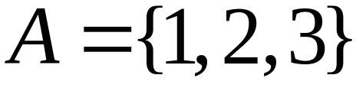

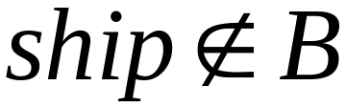
SETS
A set is a collection of elements
We write

Slide 4
Set Representations
  C = { a, b, c, d, e, f, g, h, i, j, k }
  C = { a, b, …, k }
  S = { 2, 4, 6, … }
  S = { j : j > 0, and j = 2k for some k>0 }
  S = { j : j is nonnegative and even }
finite set
infinite set

Slide 5
A = { 1, 2, 3, 4, 5 }
U
6
A
2
8
1
3
7
4
5
9
10
Universal Set: all possible elements
    U = { 1 , … , 10 }

Slide 6
Set Operations
A = { 1, 2, 3 } B = { 2, 3, 4, 5}
Union
A U B = { 1, 2, 3, 4, 5 }
Intersection
    A B = { 2, 3 }
Difference
    A - B = { 1 }
    B - A = { 4, 5 }
A
B
2
4
1
3
5
U
2
3
1
Venn diagrams

Slide 7
Complement
      Universal set = {1, …, 7}
      A = { 1, 2, 3 } A = { 4, 5, 6, 7}
4
A
A
6
1
3
2
5
7
A = A

Slide 8
{ even integers } = { odd integers }
Integers
1
odd
0
5
even
2
6
4
3
7

Slide 9
Exercise (1-2)
1. With S1 = {2, 3, 5, 7},
S2 = {2, 4, 5, 8, 9}, and U = {1 : 10}, compute ¬S1 ∪ S2.
2. With S1 = {2, 3, 5, 7}
and S2 = {2, 4, 5, 8, 9},
compute S1 × S2 and S2 × S1.
3. For S = {2, 5, 6, 8} and T = {2, 4, 6, 8}, compute |S ∩ T| + |S ∪ T|.

Slide 10
DeMorgan’s Laws
A U B = A B
U
A B = A U B
U

Slide 11
Exercise (2-2)
4. Prove DeMorgan’s laws, Equations (1.2) and (1.3), by showing that if an element x is in the set on one side of the equality, then it must also be in the set on the other side of the equality.
5. Show that for all sets S and T,
S − T = S ∩ ¬T.

Slide 12
Empty, Null Set:
= { }
S U = S
S =
S - = S
- S =
U
= Universal Set

Slide 13
Subset
A = { 1, 2, 3} B = { 1, 2, 3, 4, 5 }
U
A B
Proper Subset:
U
A B
B
A

Slide 14
Disjoint Sets
A = { 1, 2, 3 } B = { 5, 6}
A B =
U
A
B

Slide 15
Set Cardinality
For finite sets
A = { 2, 5, 7 }
|A| = 3
(set size)

Slide 16
Powersets
A powerset is a set of sets
S = { a, b, c }
Powerset of S = the set of all the subsets of S
2^{S} = { , {a}, {b}, {c}, {a, b}, {a, c}, {b, c}, {a, b, c} }
Observation: | 2^{S} | = 2^{|S|} ( 8 = 2³ )

Slide 17
Cartesian Product
A = { 2, 4 } B = { 2, 3, 5 }
A X B = { (2, 2), (2, 3), (2, 5), ( 4, 2), (4, 3), (4, 5) }
|A X B| = |A| |B|
Generalizes to more than two sets
A X B X … X Z

Slide 18
FUNCTIONS
domain
range
4
A
B
f(1) = a
1
a
2
b
3
c
5
f : A -> B
If A = domain
then f is a total function
otherwise f is a partial function

Slide 19
RELATIONS
R = {(x₁, y₁), (x₂, y₂), (x₃, y₃), …}
x_{i} R y_{i}
e. g. if R = ‘>’: 2 > 1, 3 > 2, 3 > 1

Slide 20
Equivalence Relations
Reflexive: x R x
Symmetric: x R y y R x
Transitive: x R y and y R z x R z
Example: R = ‘=‘
x = x
x = y y = x
x = y and y = z x = z

Slide 21
Equivalence Classes
For equivalence relation R
equivalence class of x = {y : x R y}
Example:
R = { (1, 1), (2, 2), (1, 2), (2, 1),
(3, 3), (4, 4), (3, 4), (4, 3) }
Equivalence class of 1 = {1, 2}
Equivalence class of 3 = {3, 4}

Slide 22
GRAPHS
A directed graph
e
b
node
a
d
edge
c
Nodes (Vertices)
V = { a, b, c, d, e }
Edges
E = { (a,b), (b,c), (b,e),(c,a), (c,e), (d,c), (e,b), (e,d) }

Slide 23
Labeled Graph
2
6
e
2
b
1
3
a
d
6
5
c

Slide 24
Walk
e
b
a
d
c
Walk is a sequence of adjacent edges
(e, d), (d, c), (c, a)

Slide 25
Path
e
b
a
d
c
Path is a walk where no edge is repeated
Simple path: no node is repeated

Slide 26
Cycle
e
base
b
3
1
d
a
2
c
Cycle: a walk from a node (base) to itself
Simple cycle: only the base node is repeated

Slide 27
Euler Tour
8
base
7
e
b
1
4
6
5
d
a
2
3
c
A cycle that contains each edge once

Slide 28
Hamiltonian Cycle
5
base
e
b
1
4
a
2
d
3
c
A simple cycle that contains all nodes

Slide 29
Finding All Simple Paths
e
b
a
d
c
origin

Slide 30
Step 1
e
b
a
d
c
origin
(c, a)
(c, e)

Slide 31
Step 2
e
b
a
d
(c, a)
(c, a), (a, b)
(c, e)
(c, e), (e, b)
(c, e), (e, d)
c
origin

Slide 32
Step 3
e
b
a
d
(c, a)
(c, a), (a, b)
(c, a), (a, b), (b, e)
(c, e)
(c, e), (e, b)
(c, e), (e, d)
c
origin

Slide 33
Step 4
e
b
a
d
(c, a)
(c, a), (a, b)
(c, a), (a, b), (b, e)
(c, a), (a, b), (b, e), (e,d)
(c, e)
(c, e), (e, b)
(c, e), (e, d)
c
origin

Slide 34
Trees
root
parent
leaf
child
Trees have no cycles

Slide 35
root
Level 0
Level 1
leaf
Height 3
Level 2
Level 3

Slide 36
Binary Trees

Slide 37
PROOF TECHNIQUES
Proof by induction
Proof by contradiction

Slide 38
Induction
We have statements P₁, P₂, P₃, …
If we know
    for some b that P₁, P₂, …, P_{b} are true
    for any k >= b that
        P₁, P₂, …, P_{k} imply P_{k+1}
Then
Every P_{i} is true

Slide 39
Proof by Induction
Inductive basis
    Find P₁, P₂, …, P_{b} which are true
Inductive hypothesis
    Let’s assume P₁, P₂, …, P_{k} are true,
    for any k >= b
Inductive step
    Show that P_{k+1} is true

Slide 40
Example
Theorem: A binary tree of height n
has at most 2^{n} leaves.
Proof by induction:
let L(i) be the maximum number of
leaves of any subtree at height i

Slide 41
We want to show: L(i) <= 2^{i}
Inductive basis
      L(0) = 1 (the root node)
Inductive hypothesis
      Let’s assume L(i) <= 2^{i} for all i = 0, 1, …, k
Induction step
      we need to show that L(k + 1) <= 2^{k+1}

Slide 42
Induction Step
height
k
k+1
From Inductive hypothesis: L(k) <= 2^{k}

Slide 43
Induction Step
height
L(k) <= 2^{k}
k
k+1
L(k+1) <= 2 * L(k) <= 2 * 2^{k} = 2^{k+1}
(we add at most two nodes for every leaf of level k)

Slide 44
Proof by Contradiction
We want to prove that a statement P is true
    we assume that P is false
    then we arrive at an incorrect conclusion
    therefore, statement P must be true

Slide 45
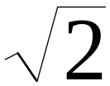
Example
Theorem: is not rational
Proof:
    Assume by contradiction that it is rational
    = n/m
    n and m have no common factors
    We will show that this is impossible

Slide 46
= n/m 2 m² = n²
n is even
n = 2 k
Therefore, n² is even
m is even
m = 2 p
2 m² = 4k²
m² = 2k²
Thus, m and n have common factor 2
Contradiction!

Slide 47
Now you try!
Prove that 1+2+3+…+n = n(n+1)/2
Notes:
Assume that 1+2+3+…+k = k(k+1)/2 is TRUE
Show true for n = k+1
1+2+3+…+k+k+1 = (k+1)(k+1+1)/2
k(k+1)/2 + 2(k+1)/2 = (k+1)(k+1+1)/2

Slide 48
More Exercises
1. Show that if S1 ⊆ S2, then S2 ⊆ S1.
2. Show that S1 = S2 if and only if
S1 ∪ S2 = S1 ∩ S2.
3. Show that S1 ∪ S2 − S1 ∩ S2 = S2.
4. Show that the distributive law
S1 ∩ (S2 ∪ S3) = (S1 ∩ S2) ∪ (S1 ∩ S3)
holds for sets.
5. Show that
S1 × (S2 ∪ S3) = (S1 × S2) ∪ (S1 × S3) .

Slide 49
More Exersices
6. Draw a picture of the graph with vertices {v1, v2, v3} and edges {(v1, v1) , (v1, v2) , (v2, v3) , (v2, v1) , (v3, v1)}. Enumerate all cycles with base v1.
7. Construct a graph with five vertices, ten edges, and no cycles.

Slide 50
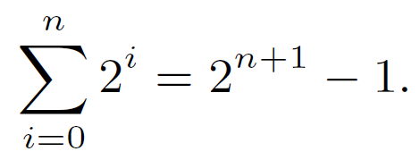
More Exersices
8. Show that
9. Show that
√8 is not a rational number.
10. Show that
√3 is irrational.

Slide 51
Languages

Slide 52
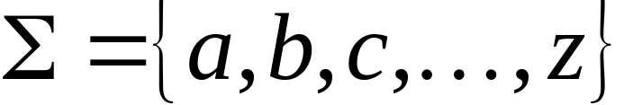
A language is a set of strings
String: A sequence of letters
  Examples: “cat”, “dog”, “house”, …
  Defined over an alphabet:

Slide 53

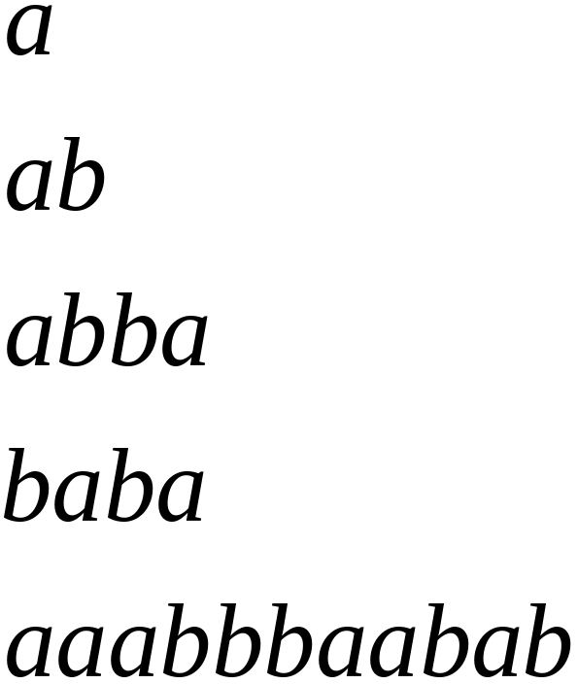
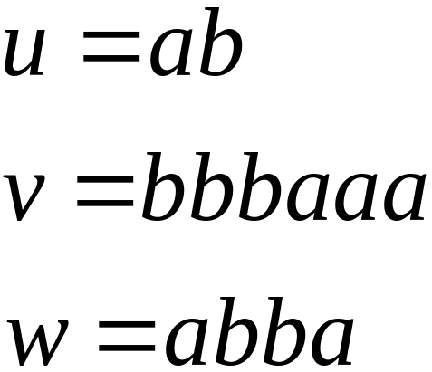
Alphabets and Strings
We will use small alphabets:
Strings

Slide 54
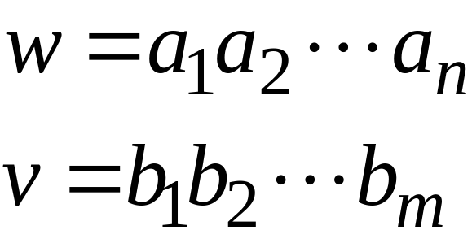
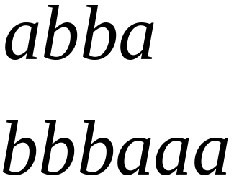
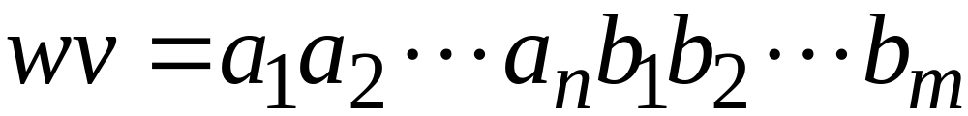

String Operations
Concatenation

Slide 55




Reverse

Slide 56


String Length
Length:
Examples:

Slide 57


Length of Concatenation
Example:

Slide 58

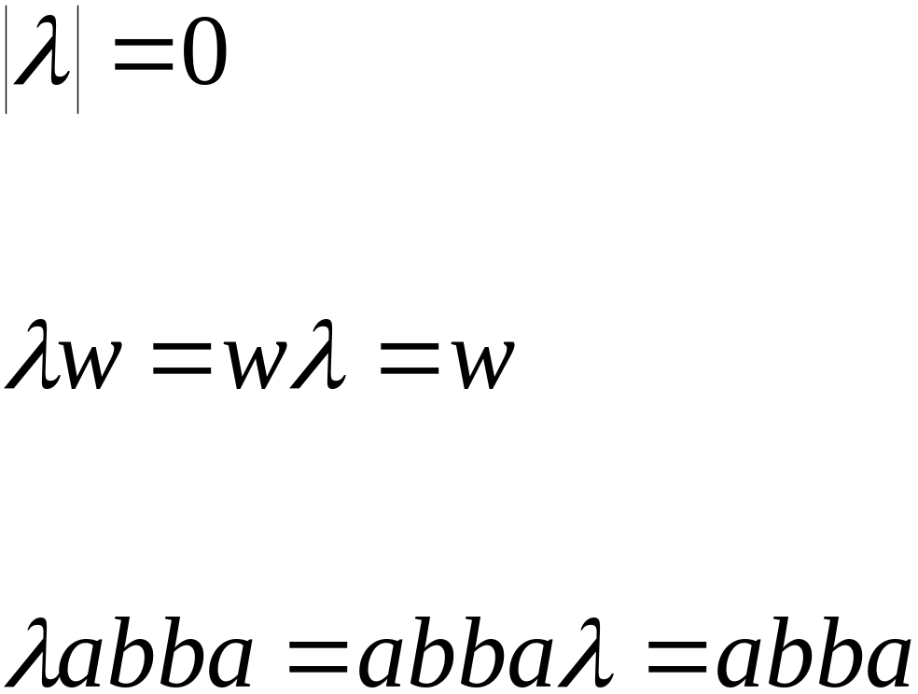
Empty String
A string with no letters:
Observations:

Slide 59


Substring
Substring of string:
  a subsequence of consecutive characters
String Substring

Slide 60




Prefix and Suffix
Prefixes Suffixes
prefix
suffix

Slide 61




Another Operation
Example:
Definition:

Slide 62



The * Operation
: the set of all possible strings from
alphabet

Slide 63

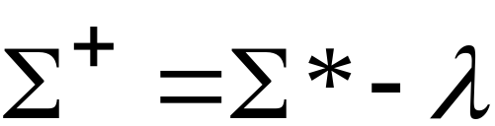
The + Operation
: the set of all possible strings from
alphabet except

Slide 64


Languages
A language is any subset of
Example:
Languages:

Slide 65




Note that:
Sets
Set size
Set size
String length

Slide 66




Another Example
An infinite language

Slide 67


Operations on Languages
The usual set operations
Complement:

Slide 68



Reverse
Definition:
Examples:

Slide 69


Concatenation
Definition:
Example:

Slide 70



Another Operation
Definition:
Special case:

Slide 71



More Examples

Slide 72


Star-Closure (Kleene *)
Definition:
Example:

Slide 73
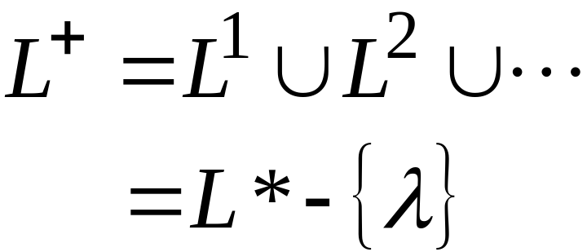

Positive Closure
Definition:

Slide 74
Exercise
Use induction on n to show that |u^{n}| = n |u| for all strings u and all n.
Let Σ = {a, b} and L = {aa, bb}. Use set notation to describe L.

